Slide 1
Chapter Seventeen
Investment Companies
©McGraw Hill LLC. All rights reserved. No reproduction or distribution without the prior written consent of McGraw Hill.

Slide 2
Investment Companies
Investment companies are FIs that pool the financial resources of individual and companies and invest those resources in (diversified) portfolios of assets
Open-end mutual funds sell new shares to investors and redeem outstanding shares on demand at their fair market values
  Single share of a mutual fund could represent ownership in over a thousand different companies
Hedge funds (HFs) are a type of investment pool that solicits funds from (wealthy) individuals and other investors (e.g., commercial banks) and invests these funds on their behalf
  Investments in HFs are restricted to more wealthy clients

Slide 3
Mutual Fund Industry
First mutual fund established in Boston in 1924
Industry grew slowly at first; since then, number of funds and asset size of industry have increased dramatically due to:
  Advent of money market mutual funds, funds that invest in securities with an original maturity under one year, in 1972
  Tax-exempt money market mutual funds first established in 1979
  Explosion of special-purpose equity, bond, emerging market, and derivative funds
  Rise in retirement funds under management by mutual funds
    Many of these retirement funds are institutional funds, mutual funds that manage retirement plans for an institutions’ employees
    Target date funds, which follow a predetermined reallocation of risk over time, and lifestyle funds, which maintain a predetermined risk level, are also popular among retirement funds
Notes:
3

Slide 4
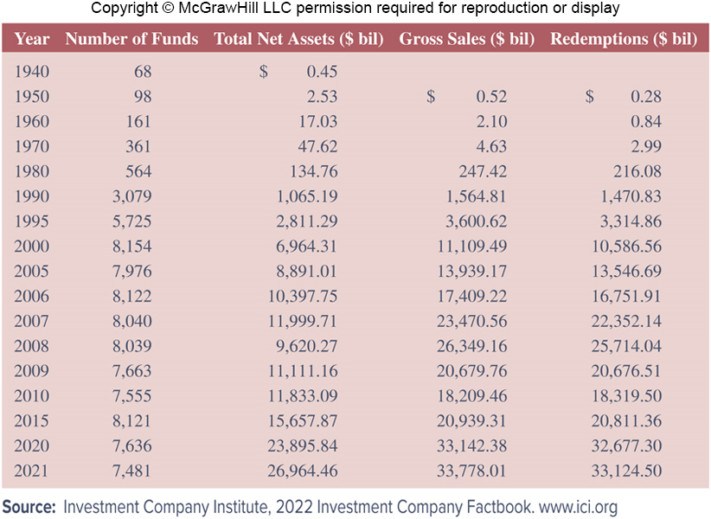
Growth of Mutual Fund Industry, 1940 - 2021
Notes:
4
Table 17–1 documents the tremendous increase in mutual funds for various years from 1940 though 2021. For example, total assets invested in mutual funds increased from $0.5 billion in 1940 to $11,999.7 billion in 2007. In addition, the number of mutual funds increased from 68 in 1940 to 8,040 in 2007.
The 2008–2009 financial crisis and the collapse in stock and other security prices produced the largest drop ever recorded in the value of industry assets. At the end of 2008, total assets fell to $9,620.3 billion. As the economy recovered in 2009, so did assets invested in mutual funds, growing to $11,111.2 billion by the end of the year and to $33,124.5 billion in 2021.

Slide 5
Mutual Fund Industry (Continued)
Mutual fund (money market and long-term mutual funds) industry is larger than the insurance industry but only slightly larger than the depository institutions industry
  Through the end of 2018, the DI industry was the largest FI group, but the mutual fund industry surpassed the DI industry in size in 2019
Low barriers to entry in the U.S. mutual fund industry have allowed new entrants to offer funds to compete for investor attention
  Share of industry assets held by largest mutual fund sponsors has changed little since 1990
  Largest 25 companies that sponsor mutual funds managed 80% of the industry’s assets in 2019, slightly larger than 76% in 1990
Notes:
5

Slide 6
Different Types of Mutual Funds
Mutual fund (MF) industry is usually considered to have two sectors: short-term funds and long-term funds
Short-term funds comprise taxable money market mutual funds (MMMFs) and tax-exempt money market funds
  Principal type of risk is interest rate risk due to predominance of fixed-income securities, but this risk is mitigated to a large extent because of the shortness of maturity of the assets (often less than 60 days)
  Have virtually no liquidity or default risk
    Money market mutual funds (MMMFs) consist of various mixtures of money market securities
    Tax-exempt money market mutual funds contain various mixes of those money market securities with an original maturity of less than one year
Notes:
6

Slide 7
Different Types of Mutual Funds (Continued)
Long-term funds comprise equity funds, bond funds, and hybrid funds
  Equity funds consist of common and preferred stock securities
    Typically well diversified, and the risk is more systematic or market based
  Bond funds consist of fixed-income capital market debt securities
    Extensive interest rate risk because of their long-term, fixed-rate nature
  Hybrid funds consist of both stock and bond securities
Notes:
7

Slide 8
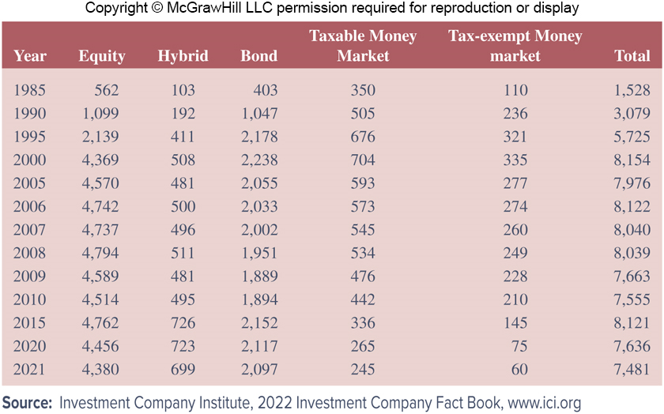
Number of Mutual Funds,
1985 through 2021
Notes:
8
Table 17–3 reports the growth in the mutual fund industry based on the number of funds in existence from 1985 through 2021.
All categories of funds have generally increased in number in this time period, from a total of 1,528 in 1985 to 8,040 in 2007. Also, the number of equity funds boomed in the 1990s: equity funds numbered 4,737 in 2007, up from 1,099 in 1990, while bond funds numbered 2,002 in 2007, up from 1,047 in 1990. But again, the 2008–2009 financial crisis and the collapse in financial markets produced a significant drop in the number of mutual funds. The number of equity and bond funds was 4,589 and 1,889, respectively, by the end of 2009. The total number of funds dropped below 8,000 for the first time since 1999. In terms of the number of funds, the industry still had not recovered from the crisis. By 2021, the number of equity funds decreased to 4,380 and the total number of funds decreased to 7,481.

Slide 9
Different Types of Mutual Funds (Concluded)
Money market mutual funds (MMMFs) provide an alternative investment opportunity to interest-bearing deposits at commercial banks
  Main difference between the two is that interest-bearing deposits (below $250,000) are fully insured by the FDIC but generally offer lower returns than noninsured MMMFs
Households own the majority of both long- and short-term funds
  As of 2021, 62.2 million U.S. households 47.9%) owned mutual funds
  Typical fund-owning household has $200,000 invested in four mutual funds
Notes:
9

Slide 10
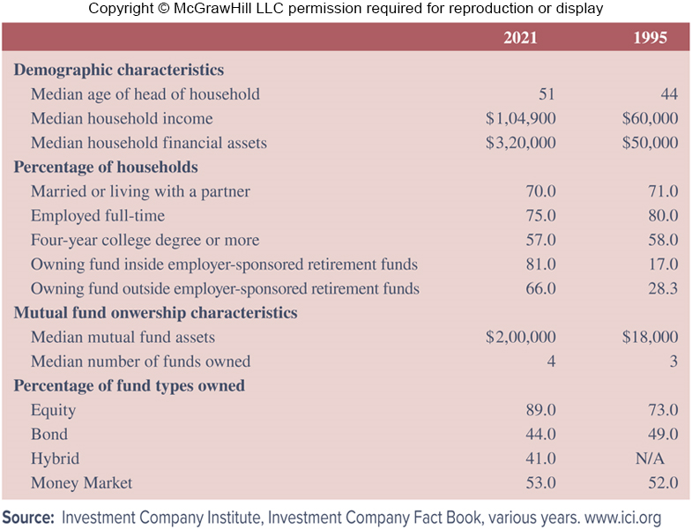
Selected Characteristics of Household Owners of Mutual Funds
Notes:
10
Table 17-4 lists some characteristics of household mutual fund owners as of 2021.

Slide 11
Other Types of Investment Company Funds
An open-end MF is a fund for which the supply of shares is not fixed, but can increase or decrease daily with purchases and redemptions of shares
  In 2021, $34.2 trillion was invested in 10,051 open-end MFs
A closed-end investment company is a specialized investment company that has a fixed supply of outstanding shares and generally do not continuously offer shares for sale
  In 2021, $309.2 billion was invested in 461 closed-end funds
  Real estate investment trust (REIT) are closed-end investment companies that specialize in investing in real estate company shares and/or in buying mortgages
Unit investment trusts (UITs) sell a fixed number of redeemable shares that are redeemed on a set termination date
  In 2021, $95.0 billion was invested in 4,112 UITs
Notes:
11
While mutual funds dominate the investment company industry, two other types of funds are managed by these firms: closed-end funds and unit investment trusts.

Slide 12
Mutual Fund Prospectus and Objectives
MF managers must specify their fund’s investment objectives in a prospectus (a formal summary of a proposed investment), which is made available to potential investors
  Provides general information about the types of securities the mutual fund holds as assets
  In 1998, the Securities and Exchange Commission (SEC) mandated that fund prospectuses must be written in “plain English” instead of overly legal language
  Individual’s preferences for a mutual fund’s objective often change over time
Notes:
12

Slide 13
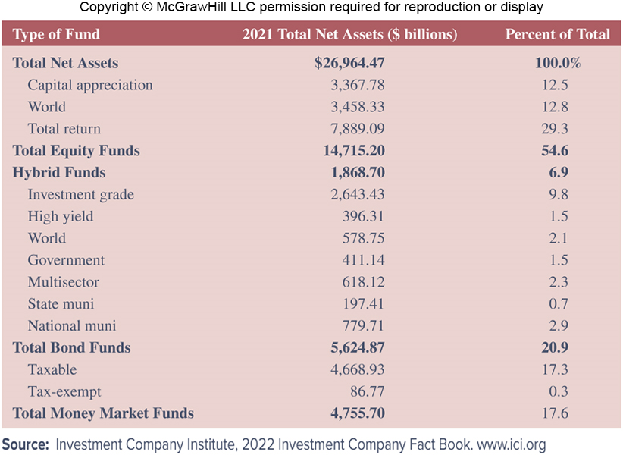
Mutual Funds: Total Net Assets by Composite Investment Objective
Notes:
13
Table 17–5 classifies 13 major categories of investment objectives for mutual funds, with the assets allocated to each of these major categories.

Slide 14
Index Funds and Exchange Traded Funds (ETFs)
In 2021, there were 496 index funds managing total net assets of $5.7 trillion, compared to 6,680 active funds with net assets of $16.5 trillion
  Index funds are funds in which managers buy securities in proportions similar to those included in a specified major index
  Index funds involve little research or management, which results in lower fees and higher returns than more actively managed funds
Exchange traded funds (ETFs) are long-term mutual funds that are also designed to replicate a particular stock market index
  Legally classified as open-end mutual funds, but similar to closed-end funds in that a fixed number of shares are outstanding at any point
  Trade intraday on a stock exchange at pries determined by the market
  Management fees are lower than actively managed mutual funds
  Unlike index funds, ETFs can be traded during the day, sold short, and purchased on margin
Notes:
14

Slide 15
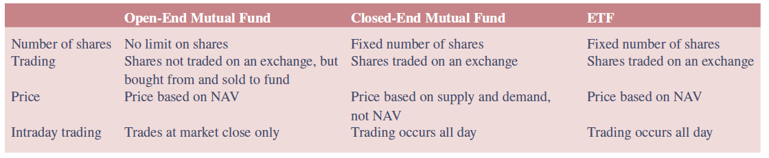
Differences among Open-End Mutual Funds, Closed-End Mutual Funds, and ETFs
Notes:
15
Table 17–7 summarizes some of the main differences and similarities of open-end mutual funds, closed-end mutual funds, and ETFs.

Slide 16
Investor Returns from Mutual Fund Ownership
Return for the investor from investing in MF shares reflects three aspects of the underlying portfolio of MF assets:
  Portfolio earns income and dividends on those assets
  Capital gains occur when the MF sells an asset at prices higher than the original purchase price of the asset
  Sale of additional MF shares and the profitable investment made with the funds from these shares can produce a capital appreciation that adds to the value of all shares in the MF
Mutual fund assets are normally marked to market daily
  Managers of fund calculate current value of each share by computing daily market value of fund’s total asset portfolio less any liabilities and then dividing this amount by number of shares outstanding
Net asset value (NAV) of a MF share is equal to the market value of the assets in the MF portfolio divided by the number of shares outstanding
Notes:
16

Slide 17
Mutual Fund Costs
Sales loads
  Load fund has an up-front (one-time) sales or commission charge that the investor must pay
    Argument in favor of load funds is that they provide the investor with more personal attention and advise on fund selection
  No-load fund does not charge up-front sales or commission charges on the sale of MF shares to investors
Fund operating expenses are annual fees
  Management fee is charged to meet operating costs (e.g., administration and shareholder services)
    Generally the largest fee charged to MF owners
  12b-1 fees relate to the distribution costs of MF shares
    Distribution fees include fees paid for marketing and selling fund shares
    Under FINRA rules, 12b-1 fees that are used to pay marketing and distribution expenses (as opposed to shareholder service expenses) cannot exceed 0.75% of a fund’s average net assets per year
Notes:
17
Mutual funds charge shareholders a price or fee for the services they provide (i.e., management of a diversified portfolio of financial securities). Two types of fees are incurred by investors: sales loads and fund operating expenses.

Slide 18
Mutual Fund Costs (Continued)
Often, funds offer different share classes (all of which invest in the same underlying portfolio of assets), but each share class may offer investors different methods of paying for broker services
  Class A shares carry a front-end load that is charged at the time of purchase as a percentage of the sales price and usually have an annual 12b-1 fee between 25 and 35 basis points of the portfolio’s assets
  Class B shares are offered for sale at NAV without a front-end load, but charge an annual 12b-1 fee (usually 1%) and a back-end load (usually based on the lesser of the original cost of the shares or the market value at the time of sale)
  Class C shares are offered at NAV with no front-end load, but charge an annual 12b-1 fee of 1% and a back-end load (set at 1% in first year of purchase; not charged on redemption after first year)
Notes:
18
Most funds sold in multiple classes offer investors three payment plans through three share classes (A, B, and C), each having different mixes of sales loads and 12b-1 fees.

Slide 19
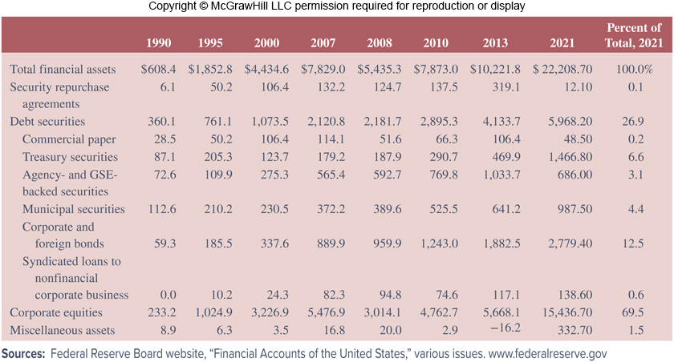
Distribution of Assets in Long-Term Mutual Funds from 1990-2021
Notes:
19
Note the asset distribution of long-term mutual funds in Table 17–8.

Slide 20
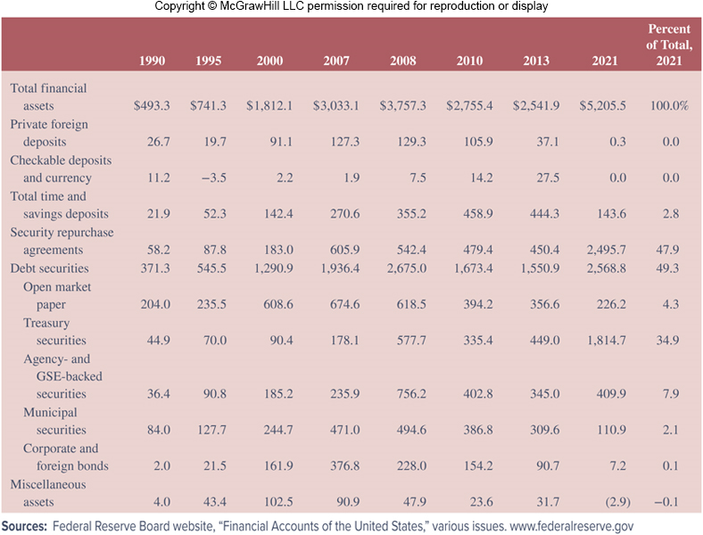
Distribution of Assets in Money Market Mutual Funds, 1990-2021
Notes:
20
Look at the distribution of assets of money market mutual funds from 1990 through 2021 in Table 17–9.

Slide 21
Mutual Fund Regulation
MFs are heavily regulated because they manage and invest small investor savings; SEC is the primary regulator
  Securities Act of 1933 requires MF to file registration statement with SEC and sets rules and procedures regarding fund’s prospectus
  Securities Exchange Act of 1934 makes the purchase and sale of mutual fund shares subject to various antifraud provisions
  In 1940, Congress passed the Investment Advisers Act and Investment Company Act
  Insider Trading and Securities Fraud Enforcement Act of 1988 required MFs to develop mechanisms and procedures to avoid insider trading abuses
  Market Reform Act of 1990 allows the SEC to introduce circuit breakers to halt trading on exchanges and restrict program trading when deemed necessary
  National Securities Market Improvement Act (NSMIA) of 1996 exempts MF companies from oversight by state regulators
Notes:
21
The Investment Company Act established rules to prevent conflicts of interest, fraud, and excessive fees or charges for fund shares.

Slide 22
Investor Abuses
Several allegations of trading abuse and the improper assignment of fees were revealed and prosecuted in the early 2000s
Abusive activities fell into four general categories:
  Market timing is short-term trading of MFs that seeks to take advantage of short-term discrepancies between the price of a MF’s shares and out-of-date values on the securities in the fund’s portfolio
  Late trading occurs when investors are able to buy or sell MF shares after the price has been set (at 4:00 P.M. EST daily)
  Directed brokerage occurs when brokers improperly influence investors on their fund recommendations
  Improperly assessed fees occur when brokers trick customers into thinking they are buying no-load funds or fail to provide discounts properly
Notes:
22

Slide 23
Mutual Fund Regulation (Continued)
Starting October 5, 2004, the SEC requires MFs hire chief compliance officers to monitor whether a MF company is following the rules enacted to address investor abuses:
  Portfolio managers must report trading in funds they manage
  To address the problem of market timing, SEC requires funds to provide expanded disclosure of the risks of frequent trading in fund shares and of their policies and procedures regarding such activities
  MFs must be more open about their use of fair value pricing to guard against stale share prices that could produce profit for market timers
  To combat late trading abuses, SEC proposed MFs or their agents receive all trading orders by 4:00 p.m. Eastern time
  Shareholder reports must include fees shareholders paid, as well as management’s discussion of the fund’s performance over that period
  As of September 1, 2004, MF companies must provide clear information to investors on brokerage commissions and discounts
Notes:
23
As a result of the illegal and abusive activities discussed on the previous slide, rules and regulations were imposed (in 2004 and 2005) on mutual fund companies.

Slide 24
Global Issues
During the 1990s and into the 2000s, MFs were the fasting growing sector in the U.S. financial institutions industry
Worldwide (other than in the U.S.), investments in MFs increased over 187%, from $4.916 trillion in 1999 to $14.130 trillion in 2007
  This compares to growth of 75% in U.S. funds
Non-U.S. mutual funds experienced bigger losses in total assets during the financial crisis
  Worldwide funds fell to $9.316 trillion (34.1%) in 2008, while U.S. funds fell to $9.603 trillion (20.0%)
By 2021, non-U.S. investments in MFs increased to $36.90 trillion (an increase of 296.1% from 2008), while U.S. investments increased to $34.15 trillion (an increase of 255.7%)
Notes:
24

Slide 25
Hedge Funds
Hedge funds (HFs) are investment pools that invest funds for (wealthy) individuals and other investors (e.g., commercial banks)
  Similar to MFs in that they are pooled investment vehicles that accept investors’ money and generally invest it on a collective basis
  Not subject to the numerous regulations that apply to MFs for the protection of individuals
  Do not have to disclose their activities to third parties, and thus offer a high degree of privacy for their investors
  Use aggressive strategies unavailable to MFs, including short selling, leveraging, program trading, arbitrage, and derivatives trading
Historically, HFs have avoided regulation by limiting the number of investors to less than 100 individuals and by requiring investors to be “accredited”
  Accredited investors have net worth over $1 million or annual income over $200,000 ($300,000 if married)
Notes:
25

Slide 26
Hedge Funds (Continued)
Since HFs that do not exceed $100 million in assets under management do not register with the SEC, their actual data cannot be independently tracked (i.e., data are self-reported)
  Estimated that in 2021, there were over 9,400 hedge funds in the U.S., with assets of $4.01 trillion
Notes:
26
Table 17–11 lists the estimated 10 largest hedge fund firms by total assets managed in 2021.

Slide 27
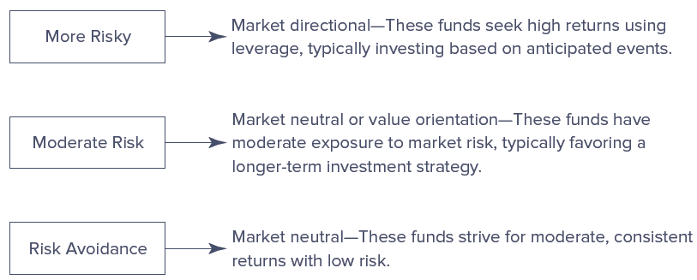
Types of Hedge Funds
Notes:
27
Figure 17–7 shows the general categories of hedge funds by risk classification.
More risky funds are the most aggressive and may produce profits in many types of market environments. Funds in this group are classified by objectives such as aggressive growth, emerging markets, macro, market timing, and short selling.
Moderate risk funds are more traditional funds, similar to mutual funds, with only a portion of the portfolio being hedged. Funds in this group are classified by objectives such as distressed securities, fund of funds, opportunistic, multistrategy, and special situations.
Risk-avoidance funds are also more traditional funds, emphasizing consistent but moderate returns while avoiding risk. Funds in this group are classified by objectives such as income, market neutral–arbitrage, market neutral–securities hedging, and value.

Slide 28
Fees on Hedge Funds
Management fees are computed as a percentage of the total assets under management (usually between 1.5% and 2.0%)
Performance fees are unique to hedge funds, and the average performance fee is approximately 20% but varies widely
  Paid to hedge fund manager before returns are paid to fund investors
  Hurdle rate is a minimum annualized performance benchmark that must be realized before a performance fee can be assessed
  High-water mark is usually used for hedge funds in which the manager does not receive a performance fee unless the value of the fund exceeds the highest net asset value it has previously achieved
    Used to link fund manager’s incentives more closely to those of fund investors and to reduce manager’s incentive to increase the risk of trades
Domestic HFs are organized in U.S., while funds located outside the U.S. and structured under foreign laws are offshore HFs
  Offshore HFs are not subject to U.S. income taxes on distributions of profit or the U.S. estate taxes on fund shares
Notes:
28
Hedge fund managers generally charge two types of fees: management fees and performance fees.
Given hedge funds’ recent record of low returns, fees are one of the key issues affecting the industry today. Investors are increasingly dissatisfied with fees and consequently pushing for more favorable arrangements.

Slide 29
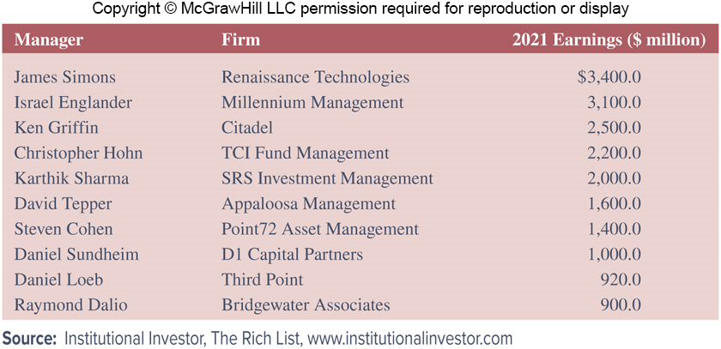
Highest-paid Hedge Fund Managers, 2021
Notes:
29
Table 17–14 lists the top 10 earnings figures for hedge fund managers in 2021.

Slide 30
Regulation of Hedge Funds
While MFs are very highly regulated, HFs have generally been unregulated
  MFs in the U.S. are required to be registered with the SEC
HFs operate under two exemptions from registration requirements as set forth in the Investment Company Act of 1940
  Funds are exempt if they have less than 100 investors
  Funds are exempt if the investors are “accredited”
HFs are only sold via private placements, and may not be offered or advertised to the general investing public
HFs are prohibited from abusive trading practices
Wall Street Reform and Consumer Protection Act of 2010 required HF advisors with private pools of capital exceeding $100 million in assets to register with SEC and become subject to all rules which apply to registered advisors by July 2011
Notes:
30

Slide 31
Regulation of Hedge Funds (Continued)
In March 2007, the SEC charged 14 defendants in a scheme involving insiders at UBS Securities, Morgan Stanley, and several HFs and HF managers
Bernard L. Madoff Investment Securities, run by former NASDAQ chairman, Bernie Madoff, ran a $65 billion Ponzi scheme
In October 2009, a large hedge fund, Galleon Group LLC, was closed due to an insider trading scandal
Billionaire Steven A. Cohen and his former HF SAC Capital Advisors agreed to a $135 million class-action settlement in November 2016
  SAC plead guilty in 2013 to criminal-insider trading charges, and paid $1.8 billion in penalties, the largest penalty on record for an insider trading case
Notes:
31
A number of funds got mixed up in the scandals plaguing the mutual fund industry in the 2000s.

